Slide 1
Robot @ Factory - Scheduling Optimizer
PDEEC – Optimization Techniques
João Martins, José Carvalho, Maria Lopes

Slide 2



Introduction
Robot@Factory 4.0 Competition - simulates real-world scenarios involving autonomous robot deployment in factory environments;
Objective: transport boxes from the input warehouses to output warehouses and pass them through machines if necessary;
4 boxes that can have different colors;
Color defines the number of operations needed;
The number of boxes of each color is known;
The input order is only known at the start of each instance.
The robot can carry up to 4 boxes simultaneously.
Motivation: obtain the order of operations that results in the smallest distance traveled by the robot.

Slide 3
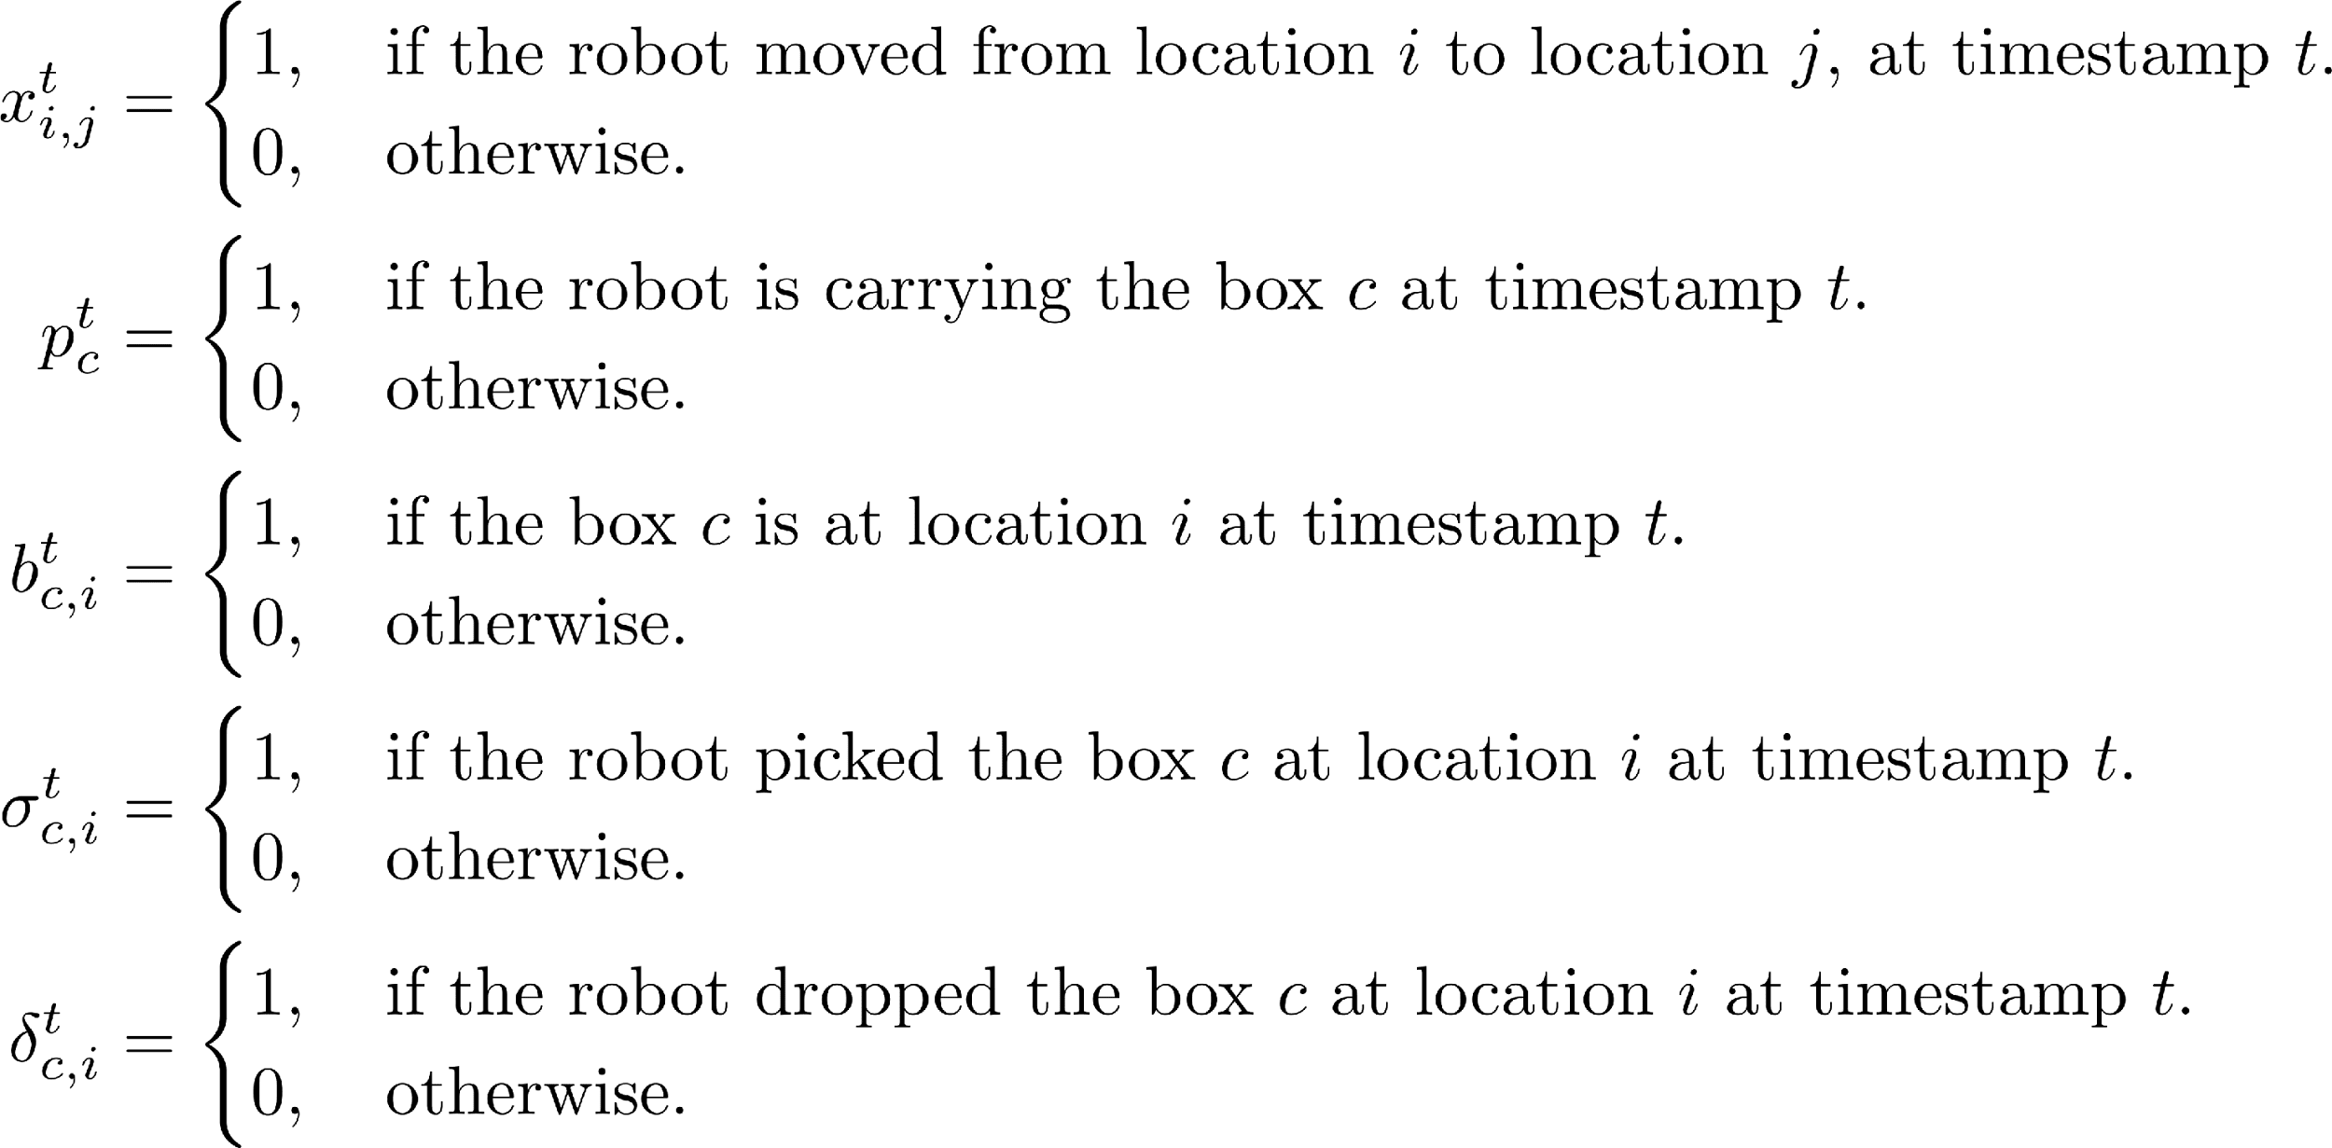
Mixed integer programming
Decision variables:

Slide 4
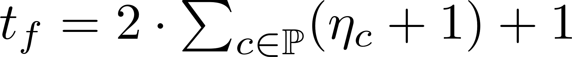
The size of the solution is known and depends on the instance data (number of operations):
The objective function is to minimize the distance traveled:
Instance
data
Defined sets

Slide 5
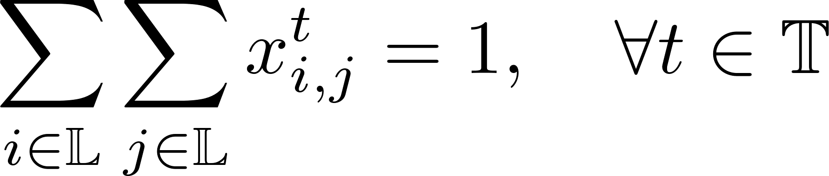
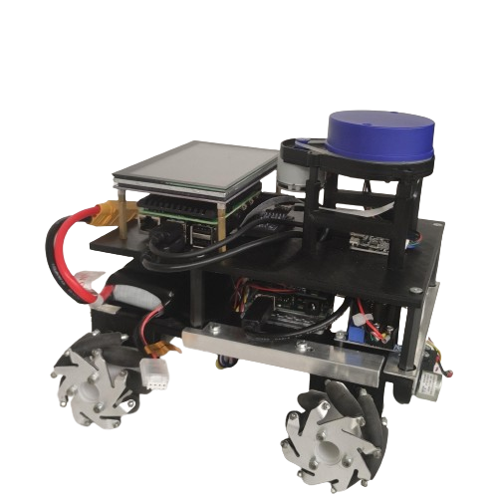
Restrictions:
Robot movement:
The robot can only move once in each timestamp
If it moved to one location, it must be in it in the next timestamp
Capacity:
Must not be surpassed;
Picking a box decreases the capacity;
Dropping a box increases the capacity
Boxes:
After being picked, they are not in the previous location;
After being dropped, they remain in that location;
At the final timestamp, they all need to be at the output warehouse;
… (27 restrictions)

Slide 6
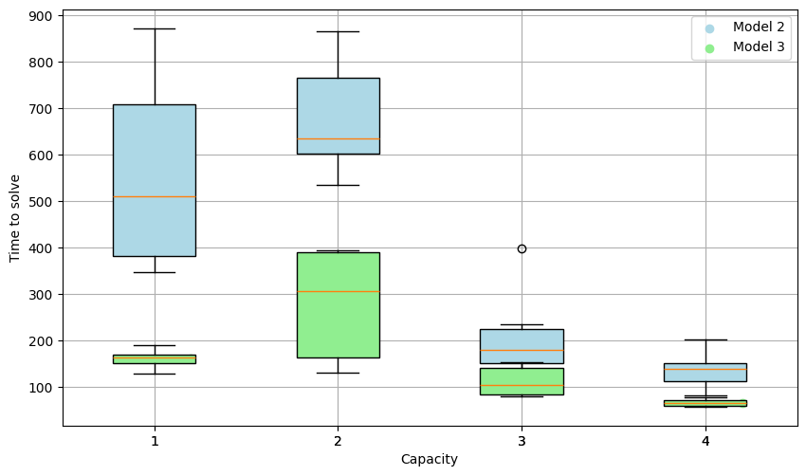
Solving Times for Round 2:
Solving times increased with model complexity.
Model 2 is less restrictive in the machines to be used, leading to higher solving time.

Slide 7
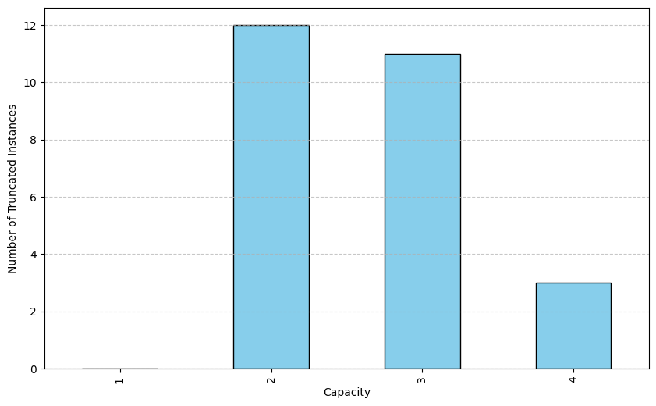
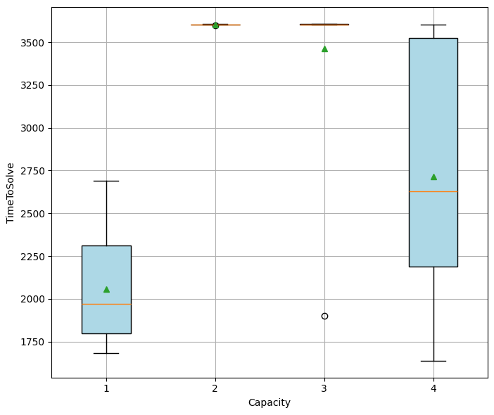
Solving Times for Round 3:
Solving times increase with number of operations.
Stage 3 has more operations increasing the solving time.
1h is not enough time to find the optimal solution in most cases.

Slide 8
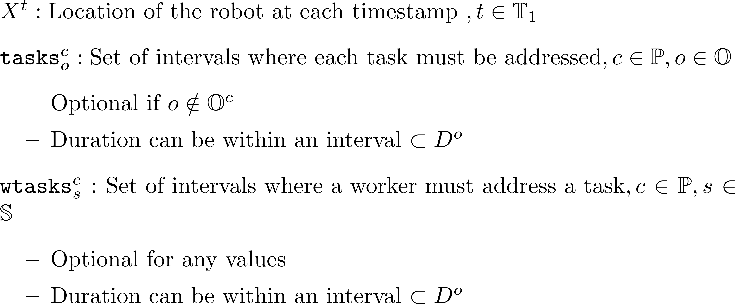
Constraint programming
Decision Variables:

Slide 9
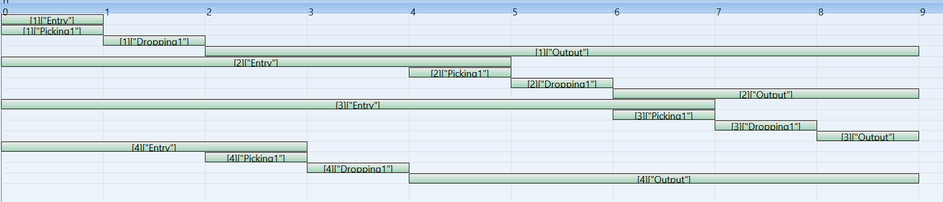
Instance Scheduling
Box 4

Slide 10
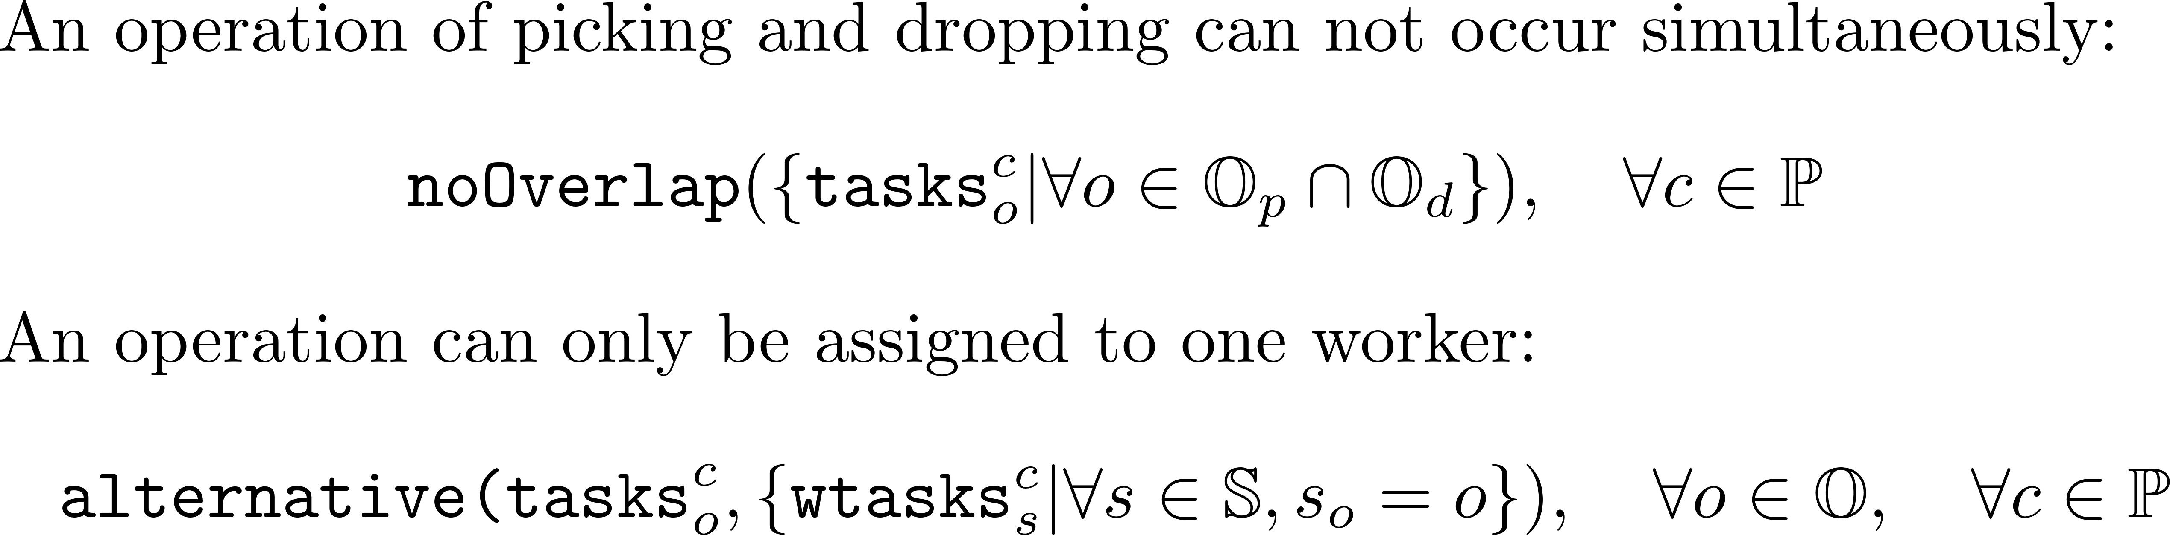
Restrictions:
More related to temporal relations between tasks
Simplified due to the use of the existing CP functions
17 restrictions in total
Some extra are used just to reduce the search space
Examples:

Slide 11
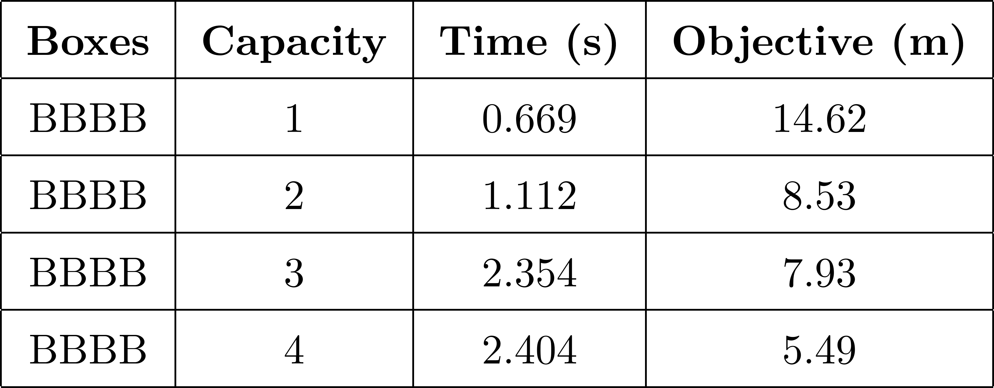
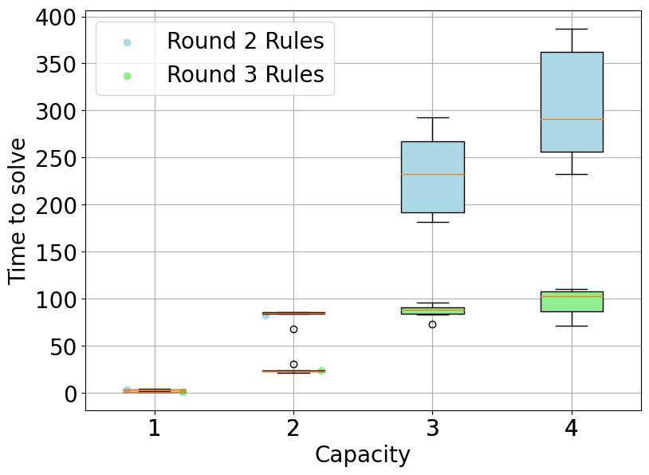
Solving Times for Round 2:
Solving times increased over the robot's capacity
Although it takes minutes to search all solution space, the optimal solution is found within few seconds.

Slide 12
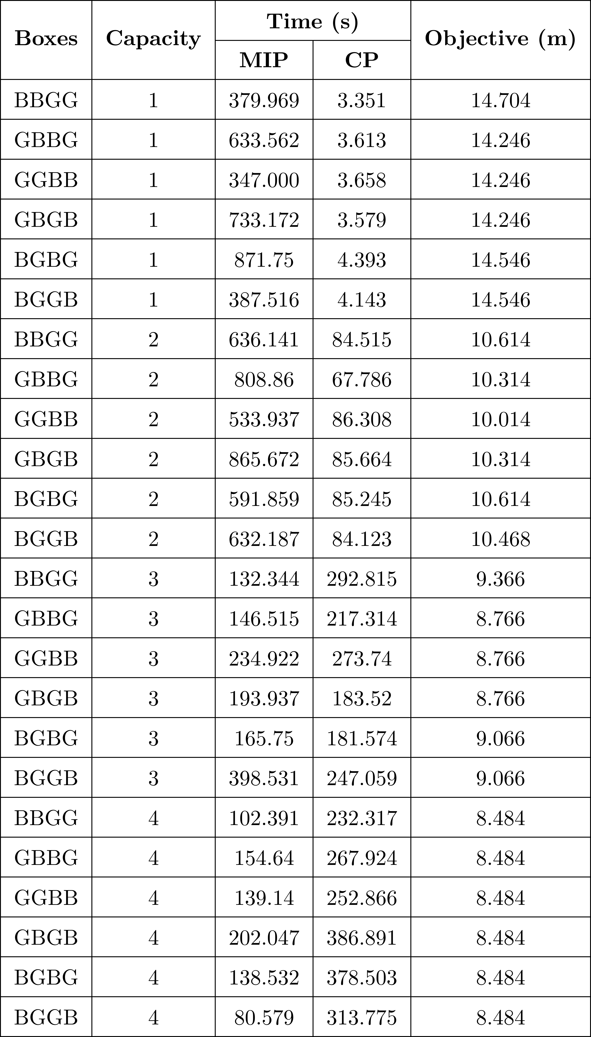
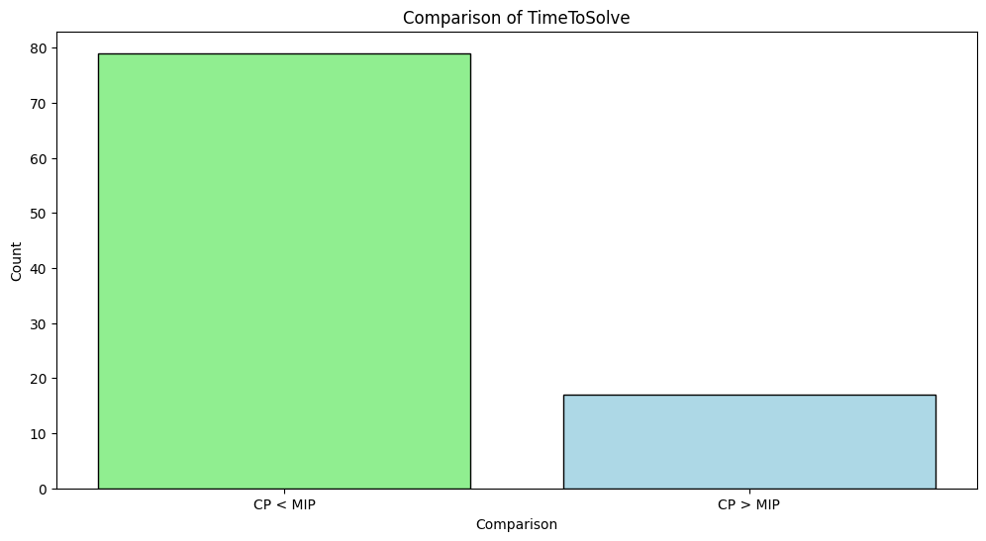
Comparison - MIP vs CP
CP can be 200x faster than MIP, showing to be faster for most cases.
However, MIP outperforms CP for C=4 in Round 2.

Slide 13
Conclusions
With the employed optimization techniques, we solved the Robot@Factory 4.0 Competition, achieving optimal solution for the minimum distance scheduling problem.
We showed that the MIP scales poorly with problem complexity as the number of operations increases while not being as sensitive to the robot carry capacity.
The CP model can obtain the optimal solution in seconds. Still, when given the possibility of parallelizing the movement of the boxes, the time the engine takes to explore the whole solution space greatly increases.
While CP is clearly the most viable technique, the issue of taking too long to search the solution space should be addressed. One option might be to add more Global Constraints such as allDifferent.

Slide 14
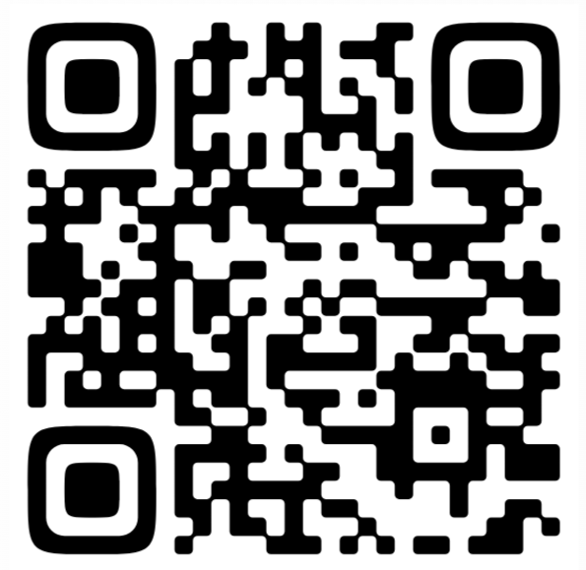
Robot @ Factory - Scheduling Optimizer
PDEEC – Optimization Techniques
João Martins, José Carvalho, Maria Lopes

